Slide 1
Distributed File Systems
6.1 Introduction
6.2 File service architecture
6.3 Sun Network File System (NFS)
6.5 Recent advances
8.6 Summary

Slide 2
Learning objectives
Understand the requirements that affect the design of distributed services
NFS: understand how a relatively simple, widely-used service is designed
  Obtain a knowledge of file systems, both local and networked
  Caching as an essential design technique
  Remote interfaces are not the same as APIs
  Security requires special consideration
Recent advances: appreciate the ongoing research that often leads to major advances

Slide 3
What is a file system?
Persistent stored data sets
Hierarchic name space visible to all processes
API with the following characteristics:
  access and update operations on persistently stored data sets
  Sequential access model (with additional random facilities)
Sharing of data between users, with access control
Concurrent access:
  certainly for read-only access
  what about updates?
Notes:
A file system is a subsystem of the operating system that performs file management activities such as organization, storing, retrieval, naming, sharing, and protection of files. It provides an abstraction of a storage device, that is it is a convenient mechanism for storing and retrieving information from the storage device. (Pradeep, Page 421)

Slide 4
What is a file system?
filedes = open(name, mode)
Opens an existing file with the given name.
filedes = creat(name, mode)
Creates a new file with the given name.
Both operations deliver a file descriptor referencing the open
file. The mode is read, write or both.
status = close(filedes)
Closes the open file filedes.
count = read(filedes, buffer, n)
Transfers n bytes from the file referenced by filedes to buffer.
count = write(filedes, buffer, n)
Transfers n bytes to the file referenced by filedes from buffer.
Both operations deliver the number of bytes actually transferred
and advance the read-write pointer.
pos = lseek(filedes, offset,
Moves the read-write pointer to offset (relative or absolute,
whence)
depending on whence).
status = unlink(name)
Removes the file name from the directory structure. If the file
has no other names, it is deleted.
status = link(name1, name2)
Adds a new name (name2) for a file (name1).
status = stat(name, buffer)
Gets the file attributes for file name into buffer.
*

Slide 5
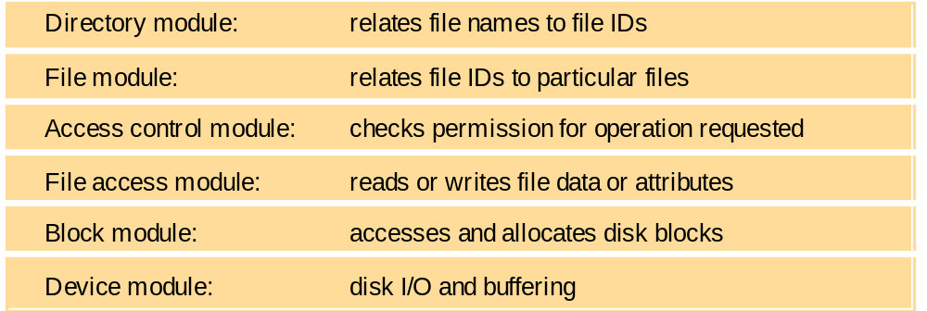
What is a file system?
*

Slide 6
What is a file system?
File Service- concerned with implementing operations on the contents of files.
  Unique File Identifiers(UFDIs) (long integers)are used to refer to files in all service requests for service
Directory Service - provides mapping between text names for files and their UFIDs.
  When a file is created, the client module must record the UFID of each file in a directory, together with a text name
  Provides the functions needed to generate and update directories and obtain UFIDs from directories
  It is a client of the flat file service; its directory files are stored in the files of the flat file servce
Client Module – runs in each client computer and extends operations of both the file and directory service under one single interface
  Holds information about the network locations of the flat file serve and directory server processes
  Implements a cache of recently-used file blocks at the client
*

Slide 7
What is a file system?
File length
Creation timestamp
updated
by system:
Read timestamp
Write timestamp
Attribute timestamp
Reference count
Owner
updated
by owner:
File type
Access control list
E.g. for UNIX: rw-rw-r--
*

Slide 8
File service requirements
Transparency
Concurrency
Replication
Heterogeneity
Fault tolerance
Consistency
Security
Efficiency..
Tranparencies
Access: Same operations
Location: Same name space after relocation of files or processes
Mobility: Automatic relocation of files is possible
Performance: Satisfactory performance across a specified range of system loads
Scaling: Service can be expanded to meet additional loads
Concurrency properties
Isolation
File-level or record-level locking
Other forms of concurrency control to minimise contention
Replication properties
File service maintains multiple identical copies of files
Load-sharing between servers makes service more scalable
Local access has better response (lower latency)
Fault tolerance
Full replication is difficult to implement.
Caching (of all or part of a file) gives most of the benefits (except fault tolerance)
Security
Must maintain access control and privacy as for local files.
  based on identity of user making request
  identities of remote users must be authenticated
  privacy requires secure communication
Service interfaces are open to all processes not excluded by a firewall.
  vulnerable to impersonation and other attacks
Heterogeneity properties
Service can be accessed by clients running on (almost) any OS or hardware platform.
Design must be compatible with the file systems of different OSes
Service interfaces must be open - precise specifications of APIs are published.
Efficiency
Goal for distributed file systems is usually performance comparable to local file system.
Fault tolerance
Service must continue to operate even when clients make errors or crash.
at-most-once semantics
at-least-once semantics
  requires idempotent operations
Service must resume after a server machine crashes.
If the service is replicated, it can continue to operate even during a server crash.
Consistency
Unix offers one-copy update semantics for operations on local files - caching is completely transparent.
Difficult to achieve the same for distributed file systems while maintaining good performance and scalability.
*

Slide 9
Model file service architecture
Lookup
AddName
GetNames
Client computer
Server computer
Application
Application
Directory service
program
program
Flat file service
Client module
Read
Write
Create
Delete
GetAttributes
SetAttributes
*
Notes:
Popup shows names of the file and directory operations.
If the Unix file primitives are mapped directly onto file server operations, it is impossible to support many of the requirements outlined on the previous slide.
Instead, the file service is implemented in part by a module that runs in the the client computer. The Client module implements nearly all of the state-dependent functionality (open files, position of read-write pointer, etc.)- supporting fault tolerance - and it maintains a cache of recently-used file data - efficiency, limited replication and scalability. It also translates the file operations performed by applications into the API of the file server - transparency and heterogeneity. It supplies authentication information and performs encryption when necessary, but access control checks must be made by the server.

Slide 10
Server operations for the model file service
Flat file service
Read(FileId, i, n) -> Data
Write(FileId, i, Data)
Create() -> FileId
Delete(FileId)
GetAttributes(FileId) -> Attr
SetAttributes(FileId, Attr)
Directory service
Lookup(Dir, Name) -> FileId
AddName(Dir, Name, FileId)
UnName(Dir, Name)
GetNames(Dir, Pattern) -> NameSeq
position of first byte
position of first byte
Pathname lookup
Pathnames such as '/usr/bin/tar' are resolved by iterative calls to lookup(), one call for each component of the path, starting with the ID of the root directory '/' which is known in every client.
FileId
A unique identifier for files anywhere in the network.
*
Notes:
Note that open files and RW pointer are eliminated from this interface.
All Flat File service (and Directory Service) operations are repeatable - idempotent - except Create. Neither of the server modules maintains any state on behalf of the client (unless encryption is used).

Slide 11
Case Study: Sun NFS
An industry standard for file sharing on local networks since the 1980s
An open standard with clear and simple interfaces
Closely follows the abstract file service model defined above
Supports many of the design requirements already mentioned:
  Transparency
    Access Transparency – client module provides an API that is uniform
    Location Transparency – each client adds remote file systems to its local name space (remote mounted)
    Failure Transparency – the service is stateless and most operations are Idempotent
    Performance transparency – using cache
    Migration Transparency – use the mount service – updated to automounter (dynamic)
  heterogeneity
  efficiency
  fault tolerance
Limited achievement of: Concurrency transparency, replication, consistency, Security, Scalability,
First file service that was designed as a product

Slide 12
NFS architecture
Client computer
Client computer
Application
NFS
Client
Server computer
program
Application
Application
Application
program
program
Kernel
program
UNIX
system calls
UNIX kernel
Virtual file system
Virtual file system
Operations
on local files
Operations
on
remote files
UNIX
Other
file system
NFS
Client
UNIX
file
NFS
NFS
file
system
client
server
system
NFS
protocol
(remote operations)
*
Notes:
Virtual file system - module added to the UNIX kernel to distinguish between local and remote files and to translate between the UNIX-independent file identifiers used by NTS and the internal file identifiers normally used in UNIX and other file systems

Slide 13
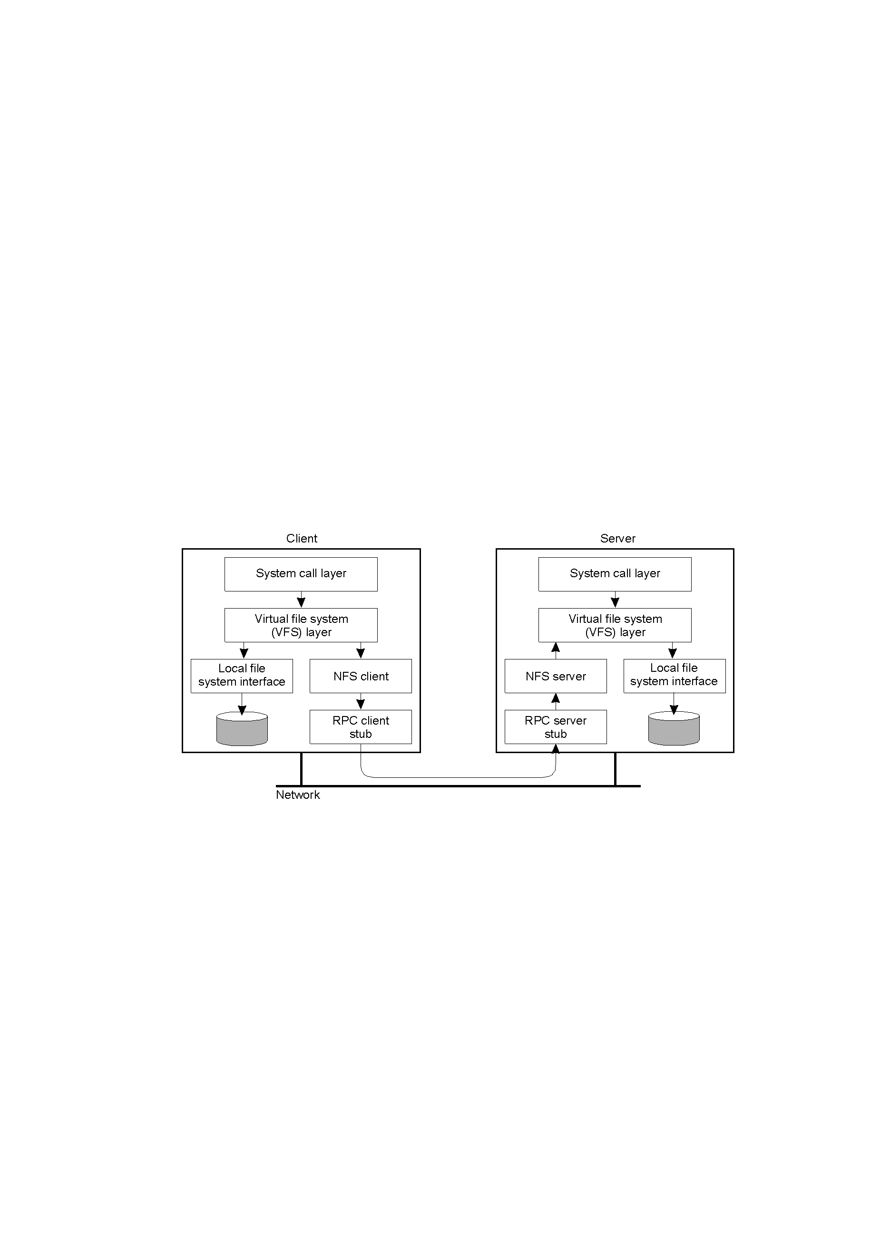
NFS Architecture (2)
The basic NFS architecture for UNIX systems.

Slide 14
NFS server operations (simplified)
The NFS client and server communicate using remote procedure calling a port mapper service is included to enable clients bind to services in a given host by name.
NFS file handles are similar to the UFIDs

Slide 15
NFS server operations (simplified)
read(fh, offset, count) -> attr, data
write(fh, offset, count, data) -> attr
create(dirfh, name, attr) -> newfh, attr
remove(dirfh, name) status
getattr(fh) -> attr
setattr(fh, attr) -> attr
lookup(dirfh, name) -> fh, attr
rename(dirfh, name, todirfh, toname)
link(newdirfh, newname, dirfh, name)
readlink(fh) -> string
mkdir(dirfh, name, attr) -> newfh, attr
rmdir(dirfh, name) -> status
Model flat file service
Read(FileId, i, n) -> Data
Write(FileId, i, Data)
Create() -> FileId
Delete(FileId)
GetAttributes(FileId) -> Attr
SetAttributes(FileId, Attr)
Model directory service
Lookup(Dir, Name) -> FileId
AddName(Dir, Name, File)
UnName(Dir, Name)
GetNames(Dir, Pattern)
->NameSeq
*
Notes:
Idempotent read/write
getattr is used to implement fstat(), setattr is used to update the attributes
NFS Create adds file to directory, whereas we use two operations in MFS
File handle – file identifies used in NFS. It is opaque to clients and contains whatever information the server needs to distinguish an individual file.
I-node number of UNIX file is a number that serves to identify and locate the field within the file system in which the file is stored
File system identifier field – unique number that is allocated to each file system when it is created
I-node generation number – needed because I-node numbers are re-used.
Access control and authentication – use of user id and group id; supplied automatically by the RPC system. This has a loophole in that a client can modify the RPC calls to include the User Id of any user, impersonating the user without their knowledge and permission
Others
Pathname translation – translates multi-part pathnames to I-done references in a step-by-step
mount service – hard or soft
Automounter – to dynamically mount a file system whenever and empty mount point is referenced by a client
server caching -
client caching –the results of read write etc

Slide 16
NFS access control and authentication
Stateless server, so the user's identity and access rights must be checked by the server on each request.
  In the local file system they are checked only on open()
Every client request is accompanied by the userID and groupID
Server is exposed to imposter attacks unless the userID and groupID are protected by encryption
Kerberos has been integrated with NFS to provide a stronger and more comprehensive security solution
*

Slide 17
Mount service
Mount operation:
mount(remotehost, remotedirectory, localdirectory)
Server maintains a table of clients who have mounted filesystems at that server
Each client maintains a table of mounted file systems holding:
< IP address, port number, file handle>
Notes:
The mounting of sub-trees of remote filesystem by clients is supported by a separate mount service process that runs at the user level on each NFS server computer.
Hard-mounted – when a use-level process accesses a file in the filesystem, the process is suspended until the request can be completed and if the remote host is unavailable for any reason, the NFS client module continues to retry the request until it is satisfied.
Soft-mount –the NFS client module returns a failure indication to user-level processes after a small number of retries.

Slide 18
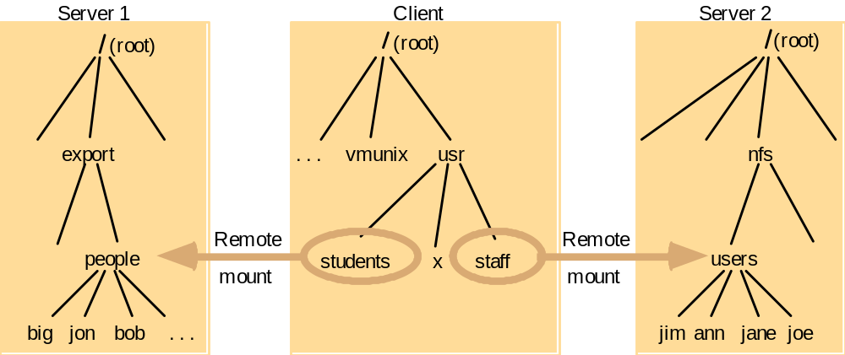
Local and remote file systems accessible on an NFS client
Note: The file system mounted at /usr/students in the client is actually the sub-tree located at /export/people in Server 1;
the file system mounted at /usr/staff in the client is actually the sub-tree located at /nfs/users in Server 2.
*

Slide 19
Kerberized NFS
Kerberos protocol is too costly to apply on each file access request
Kerberos is used in the mount service:
  to authenticate the user's identity
  User's UserID and GroupID are stored at the server with the client's IP address
For each file request:
  The UserID and GroupID sent must match those stored at the server
  IP addresses must also match
This approach has some problems
  can't accommodate multiple users sharing the same client computer
  all remote file stores must be mounted each time a user logs in
*

Slide 20
NFS optimization - server caching
Similar to UNIX file caching for local files:
  pages (blocks) from disk are held in a main memory buffer cache until the space is required for newer pages. Read-ahead and delayed-write optimizations.
  For local files, writes are deferred to next sync event (30 second intervals)
  Works well in local context, where files are always accessed through the local cache, but in the remote case it doesn't offer necessary synchronization guarantees to clients.
NFS v3 servers offers two strategies for updating the disk:
  write-through - altered pages are written to disk as soon as they are received at the server. When a write() RPC returns, the NFS client knows that the page is on the disk.
  delayed commit - pages are held only in the cache until a commit() call is received for the relevant file. This is the default mode used by NFS v3 clients. A commit() is issued by the client whenever a file is closed.
*

Slide 21
NFS optimization - client caching
Server caching does nothing to reduce RPC traffic between client and server
  further optimization is essential to reduce server load in large networks
  NFS client module caches the results of read, write, getattr, lookup and readdir operations
  synchronization of file contents (one-copy semantics) is not guaranteed when two or more clients are sharing the same file.
Timestamp-based validity check
  reduces inconsistency, but doesn't eliminate it
  validity condition for cache entries at the client:
    (T - Tc < t) v (Tm_{client} = Tm_{server})
  t is configurable (per file) but is typically set to
  3 seconds for files and 30 secs. for directories
  it remains difficult to write distributed
  applications that share files with NFS
t freshness guarantee
Tc time when cache entry was last validated
Tm time when block was last updated at server
T current time
*

Slide 22
Other NFS optimizations
Sun RPC runs over UDP by default (can use TCP if required)
Uses UNIX BSD Fast File System with 8-kbyte blocks
reads() and writes() can be of any size (negotiated between client and server)
the guaranteed freshness interval t is set adaptively for individual files to reduce gettattr() calls needed to update Tm
*

Slide 23
NFS performance
Early measurements (1987) established that:
  write() operations are responsible for only 5% of server calls in typical UNIX environments
    hence write-through at server is acceptable
  lookup() accounts for 50% of operations -due to step-by-step pathname resolution necessitated by the naming and mounting semantics.
More recent measurements (1993) show high performance:
  1 x 450 MHz Pentium III: > 5000 server ops/sec, < 4 millisec. average latency
  24 x 450 MHz IBM RS64: > 29,000 server ops/sec, < 4 millisec. average latency
  see www.spec.org for more recent measurements
Provides a good solution for many environments including:
  large networks of UNIX and PC clients
  multiple web server installations sharing a single file store
*
Notes:
Hidden

Slide 24
NFS summary
An excellent example of a simple, robust, high-performance distributed service.
Achievement of transparencies (See section 1.4.7):
  Access: Excellent; the API is the UNIX system call interface for both local and remote files.
  Location: Not guaranteed but normally achieved; naming of filesystems is controlled by client mount operations, but transparency can be ensured by an appropriate system configuration.
  Concurrency: Limited but adequate for most purposes; when read-write files are shared concurrently between clients, consistency is not perfect.
  Replication: Limited to read-only file systems; for writable files, the SUN Network Information Service (NIS) runs over NFS and is used to replicate essential system files, see Chapter 14.
cont'd *

Slide 25
NFS summary
Achievement of transparencies (continued):
  Failure: Limited but effective; service is suspended if a server fails. Recovery from failures is aided by the simple stateless design.
  Mobility: Hardly achieved; relocation of files is not possible, relocation of filesystems is possible, but requires updates to client configurations.
  Performance: Good; multiprocessor servers achieve very high performance, but for a single filesystem it's not possible to go beyond the throughput of a multiprocessor server.
  Scaling: Good; filesystems (file groups) may be subdivided and allocated to separate servers. Ultimately, the performance limit is determined by the load on the server holding the most heavily-used filesystem (file group).
*

Slide 26
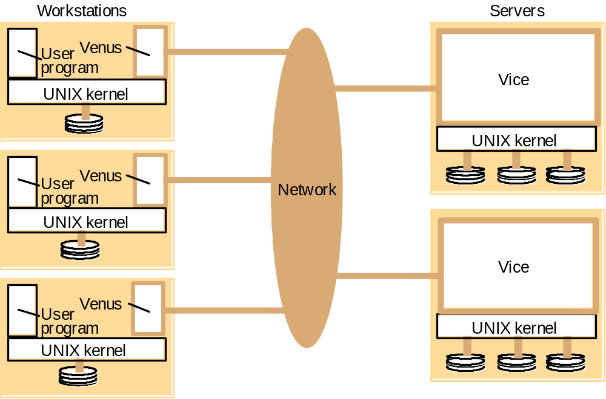
Distribution of processes in the Andrew File System
*
Notes:
AFS – scalability is the most important design goal
Unusual characteristics:
whole file serving – entire contents of directories and files are transmitted to client computers
whole file caching –
Vice- server software that runs as a user-level UNIX process in each server computer
Venus – user level process that runs in each client computer and corresponds to the client module in the abstract model.

Slide 27
Recent advances in file services
NFS enhancements
  WebNFS - NFS server implements a web-like service on a well-known port. Requests use a 'public file handle' and a pathname-capable variant of lookup(). Enables applications to access NFS servers directly, e.g. to read a portion of a large file.
  One-copy update semantics (Spritely NFS, NQNFS) - Include an open() operation and maintain tables of open files at servers, which are used to prevent multiple writers and to generate callbacks to clients notifying them of updates. Performance was improved by reduction in gettattr() traffic.
Improvements in disk storage organisation
  RAID - improves performance and reliability by striping data redundantly across several disk drives
  Log-structured file storage - updated pages are stored contiguously in memory and committed to disk in large contiguous blocks (~ 1 Mbyte). File maps are modified whenever an update occurs. Garbage collection to recover disk space.
*
Notes:
RAID = redundant arrays of inexpensive disks

Slide 28
New design approaches
Distribute file data across several servers
  Exploits high-speed networks (ATM, Gigabit Ethernet)
  Layered approach, lowest level is like a 'distributed virtual disk'
  Achieves scalability even for a single heavily-used file
'Serverless' architecture
  Exploits processing and disk resources in all available network nodes
  Service is distributed at the level of individual files
Examples:
  xFS: Experimental implementation demonstrated a substantial performance gain over NFS and AFS
  Frangipani: Performance similar to local UNIX file access
  Tiger Video File System
  Peer-to-peer systems: Napster, OceanStore (UCB), Farsite (MSR), Publius (AT&T research) - see web for documentation on these very recent systems
*

Slide 29
New design approaches
Replicated read-write files
  High availability
  Disconnected working
    re-integration after disconnection is a major problem if conflicting updates have occurred
  Examples:
    Bayou system
    Coda system
*

Slide 30
Summary
Sun NFS is an excellent example of a distributed service designed to meet many important design requirements
Effective client caching can produce file service performance equal to or better than local file systems
Consistency versus update semantics versus fault tolerance remains an issue
Most client and server failures can be masked
Superior scalability can be achieved with whole-file serving (Andrew FS) or the distributed virtual disk approach
Future requirements:
  support for mobile users, disconnected operation, automatic re-integration
  support for data streaming and quality of service
*

